Slide 1


Visualizing Uncertainty of Bathymetric Data and Under Keel Clearance
Dr. Stefan Gladisch
Fraunhofer Institute for Computer Graphics Research IGD Joachim-Jungius-Straße 11 18059 Rostock, Germany stefan.gladisch@igd-r.fraunhofer.de www.igd-r.fraunhofer.de

Slide 2
Introduction
Visualization facilitates the analysis of large amounts of data by representing them visually
However, visualization has to be done right to be efficient!
“
Humans acquire more information through vision than through all of the other senses combined.
Ware, 2004
Visual information can be communicated simultaneously, whereas numbers and written language have to be read sequentially.
Bertin 1983
“

Slide 3
Introduction
Can you trust the visualized data or is there a risk associated with them?
→ YES, there is a risk!
Every dataset has imperfections, i.e. uncertainties
When analyzing critical data, associated uncertainties must be considered too
Bathymetric data / under keel clearance data are critical for safe navigation
Approach: Visualizing data + uncertainty
Benefit: increase credibility, expressiveness, efficiency

Slide 4
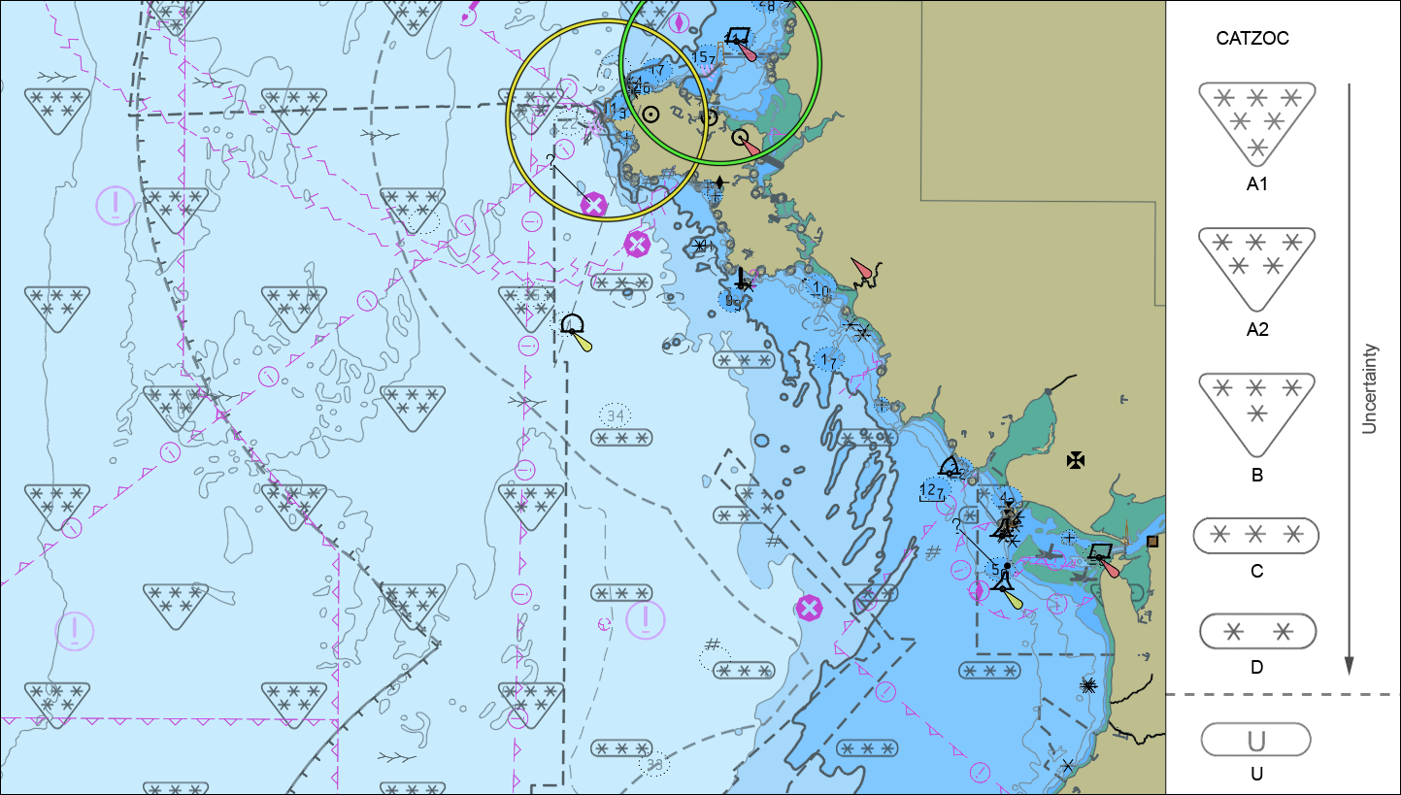
Introduction
S-52 provides an uncertainty visualization for bathymetric data, i.e. attribute M_QUAL/CATZOC
A study confirmed that CATZOC and its representation are not well suited
Fraunhofer IGD proposed novel visualization solutions for S-101

Slide 5
Aspects and Sources of Uncertainty
Uncertainty: composition of different aspects including
Accuracy / error
Precision
Currency
Completeness
Credibility
…

Slide 6


Aspects and Sources of Uncertainty
Sources and influences of uncertainty of bathymetric data:
Sources | Influences on the data
E.g. tides, wind, wave height, currents, salinity, draught, heave | Depth measurement (vertical uncertainty)
E.g. limited accuracy / precision of horizontal positioning system and heading sensor | Position measurement (horizontal uncertainty)
E.g. Range and beam angle of echo sounders, limited accuracy / precision of sensors, flaws in sensor calibration and synchronization | Depth + position measurement (vertical + horizontal uncertainty)
E.g. highly mobile or dynamic sea beds, changing water level, tides, wind, wave height, currents and salinity | Currency (temporal uncertainty)

Slide 7
Aspects and Sources of Uncertainty
Under Keel Clearance (UKC) is calculated based on
Bathymetric data
Vessel specific data
Draught
Dimensions
Stability information
Planed vessel speed
Time of passage
Traffic information
…
Further sources of uncertainty!

Slide 8
Descriptions of Uncertainty
Uncertainty visualization requires a formal description of uncertainty
Multiple aspects / sources of uncertainty should be described in an aggregated way
Qualitative description, e.g. S-57 CATZOC, S-101 QOBD
Quantitative description, e.g. maximal deviation of depth [-x m, +y m], for position p and time t
Visualizing uncertainty of UKC → quantitative description

Slide 9
Safety Margin to Eliminate Risk of UKC Uncertainty?
UKC calculation for St. Lawrence Seaway,
Annex D, UKCMPT 2016
https://www.amsa.gov.au/navigation/shipping- management/pilotage/ukcm-pilots/index.asp

Slide 10
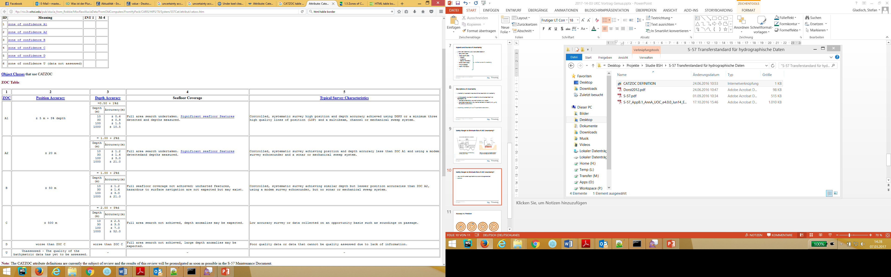
Safety Margin to Eliminate Risk of UKC Uncertainty?
May work for certain applications but cannot be generalized
Vertical uncertainty > 1m
Visualizing Uncertainty of Bathymetric Data and Under Keel Clearance – Dr. Stefan Gladisch

Slide 11
Proposals for Uncertainty Visualization: QOBD
Focus of our study: propose visualization for S-101 QOBD in ENCs
Requirements:
Bathymetric data + uncertainty must be visible simultaneously
Uncertainty visualization must not lead to visual clutter
Uncertainty visualization must be intuitive and unambiguous
Information should be represented with high contrast to each other
The visual encoding of uncertainty must be adapted according to the three ECDIS modes day, dusk and night
Important information should be encoded redundantly
…
Visualizing Uncertainty of Bathymetric Data and Under Keel Clearance – Dr. Stefan Gladisch

Slide 12
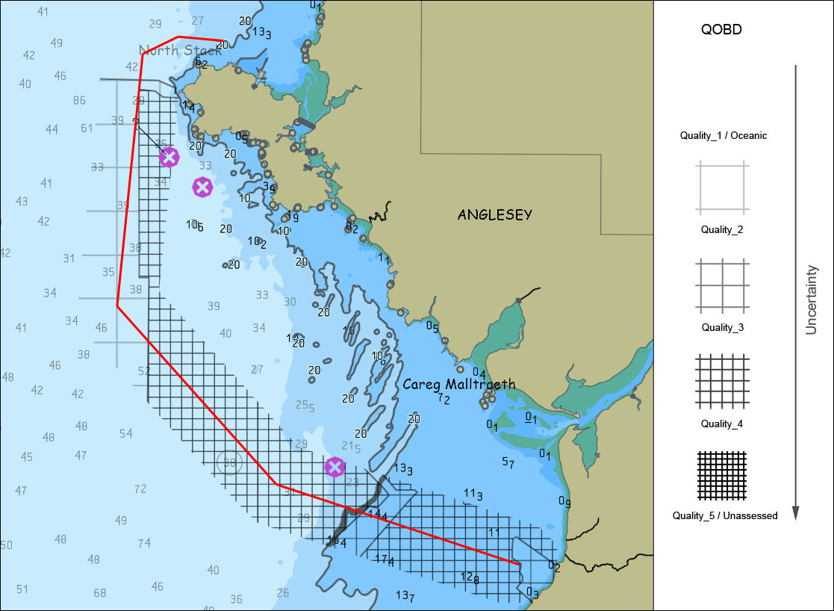
Proposals for Uncertainty Visualization: QOBD
Key ideas:
Texture overlay of varying hierarchy level and transparency
Restrict visualization to a local region of interest depending on the task: route planning / monitoring
Route planning / ECDIS mode day
Visualizing Uncertainty of Bathymetric Data and Under Keel Clearance – Dr. Stefan Gladisch

Slide 13
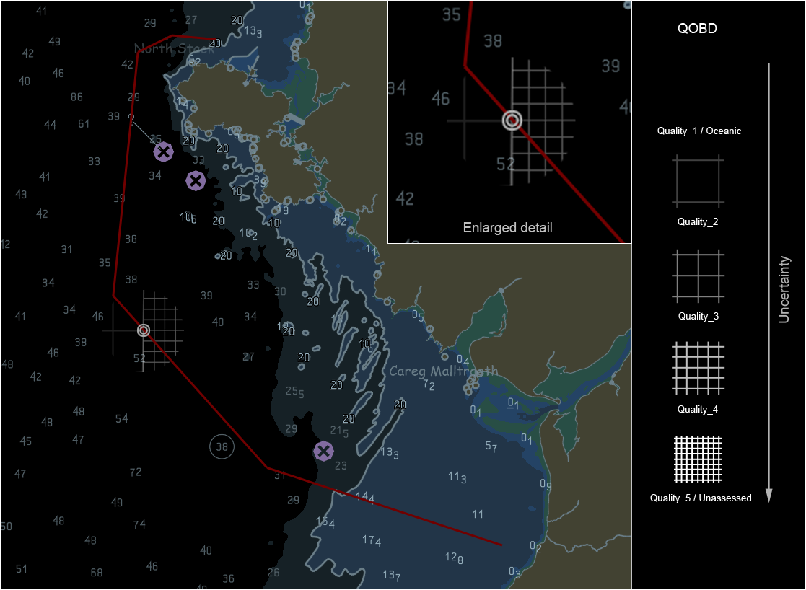
Proposals for Uncertainty Visualization: QOBD
Key ideas:
Texture overlay of varying hierarchy level and transparency
Restrict visualization to a local region of interest depending on the task: route planning / monitoring
Monitoring / ECDIS mode dusk
Visualizing Uncertainty of Bathymetric Data and Under Keel Clearance – Dr. Stefan Gladisch

Slide 14
Proposals for Uncertainty Visualization: Safe vs. potentially unsafe vs. unsafe water
Determine areas potentially unsafe for passage based on quantified uncertainty and safety contour treshold (= draught + dynamic squat + safety margin)
Visualize those areas instead of safety contour in ENC
→ Can be adapted to visualize UKC Go / potentially No-Go / No-Go areas
Visualizing Uncertainty of Bathymetric Data and Under Keel Clearance – Dr. Stefan Gladisch

Slide 15
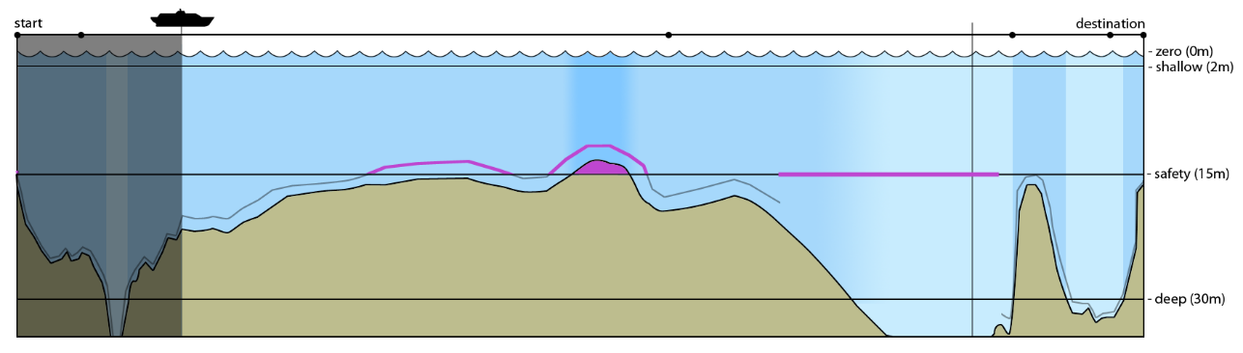
Proposals for Uncertainty Visualization: Depth Profile
Visualize quantified uncertainty of bathymetric data in an additional depth profile
Visualizing Uncertainty of Bathymetric Data and Under Keel Clearance – Dr. Stefan Gladisch

Slide 16
Proposals for Uncertainty Visualization: Depth Profile
Comparison with the visualization used in AMSA‘s UKCM
Visualizing Uncertainty of Bathymetric Data and Under Keel Clearance – Dr. Stefan Gladisch

Slide 17
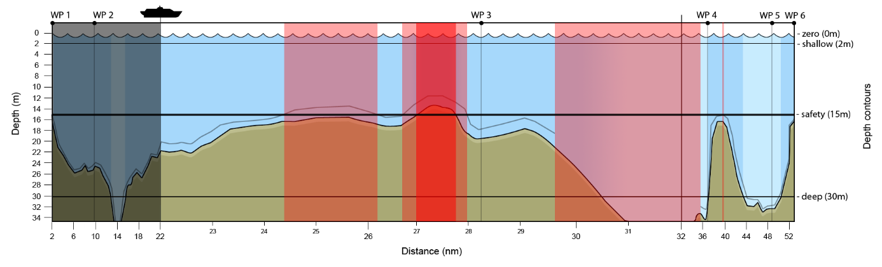
Proposals for Uncertainty Visualization: Depth Profile
Combining the benefits of both: UKC uncertainty visualization
Visualizing Uncertainty of Bathymetric Data and Under Keel Clearance – Dr. Stefan Gladisch

Slide 18
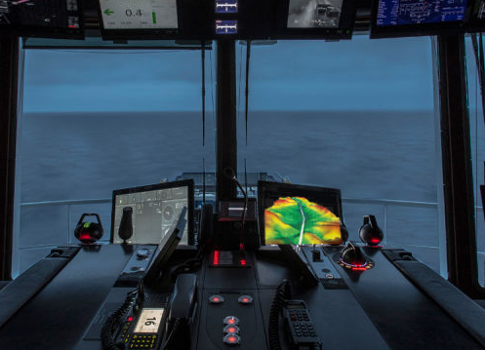
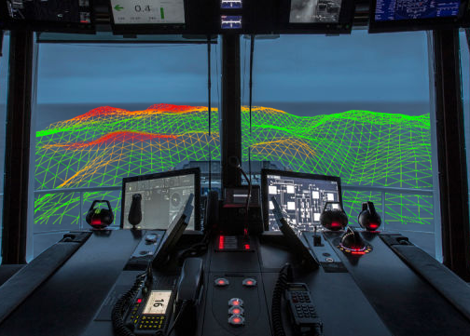
Outlook
Virtual reality / augmented reality as an aid for on-board navigation
Synthetic Vision System similiar to aircrafts?
Virtual Reality: 3D underwater terrain Augmented Reality: 3D underwater terrain +
real world environment
source: http://gizmodo.com/the-futuristic-bridge-rolls-royce-designed-for-its-new-1736707806
Visualizing Uncertainty of Bathymetric Data and Under Keel Clearance – Dr. Stefan Gladisch

Slide 19
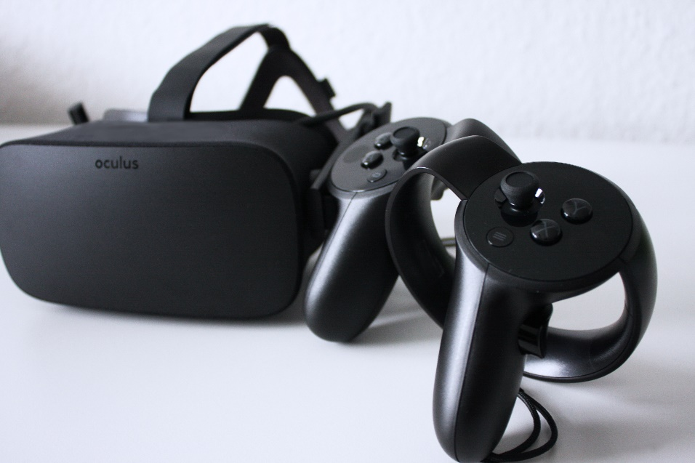
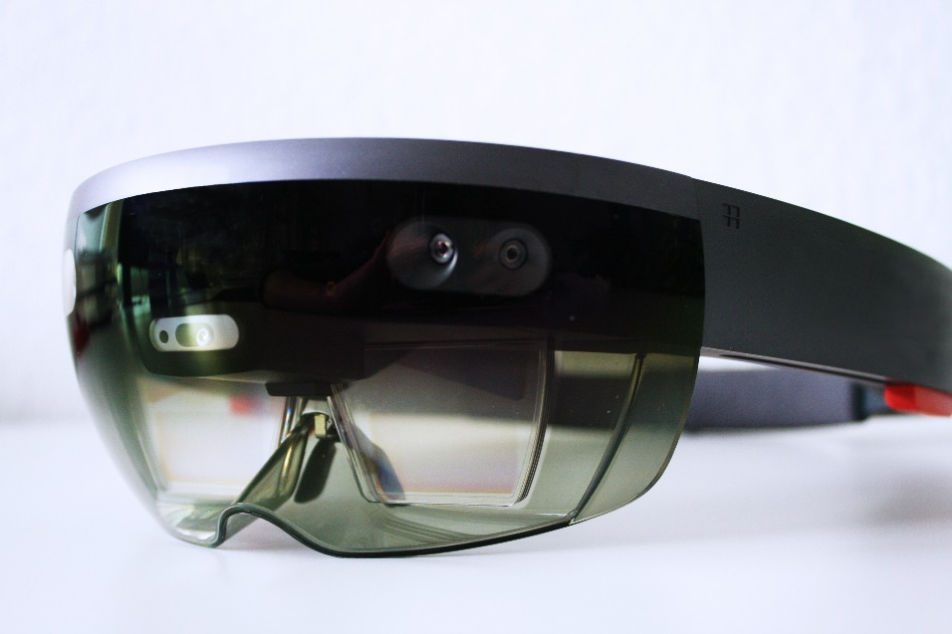
Fraunhofer IGD
We have experience in engeneering software for VR/AR devices
Interested? → contact us: stefan.gladisch@igd-r.fraunhofer.de
VR device Oculus Rift
AR device MS HoloLens
Visualizing Uncertainty of Bathymetric Data and Under Keel Clearance – Dr. Stefan Gladisch

Slide 20
Thank you for your attention
Visualizing Uncertainty of Bathymetric Data and Under Keel Clearance – Dr. Stefan Gladisch

Slide 21
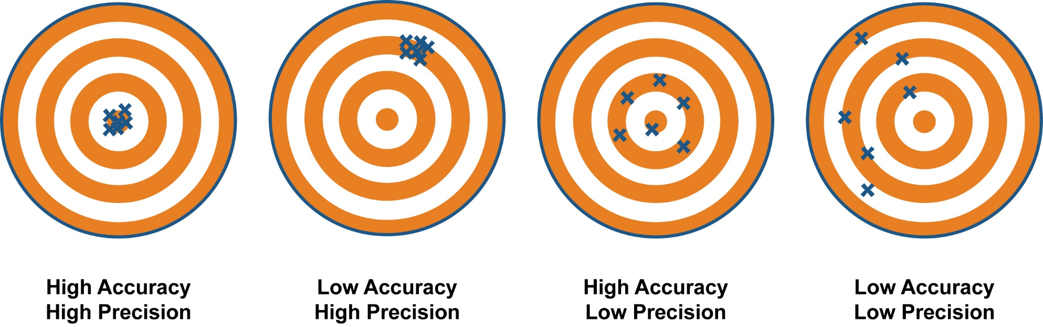
Accuracy vs. Precision
Source: http://climatica.org.uk/climate-science-information/uncertainty
Visualizing Uncertainty of Bathymetric Data and Under Keel Clearance – Dr.-Ing. Stefan Gladisch

